Slide 1
Chapter 5
Normalization of Database Tables
Database Systems:
Design, Implementation, and Management, Sixth Edition, Rob and Coronel

Slide 2
Database Tables and Normalization
Normalization
  Process for evaluating and correcting table structures to minimize data redundancies
    helps eliminate data anomalies
  Works through a series of stages called normal forms:
    Normal form (1NF)
    Second normal form (2NF)
    Third normal form (3NF)

Slide 3
Database Tables and Normalization
  2NF is better than 1NF; 3NF is better than 2NF
  For most business database design purposes, 3NF is highest we need to go in the normalization process
  Highest level of normalization is not always most desirable

Slide 4
The Need for Normalization
Example: company that manages building projects
  Charges its clients by billing hours spent on each contract
  Hourly billing rate is dependent on employee’s position
  Periodically, a report is generated that contains information displayed in Table 5.1

Slide 5
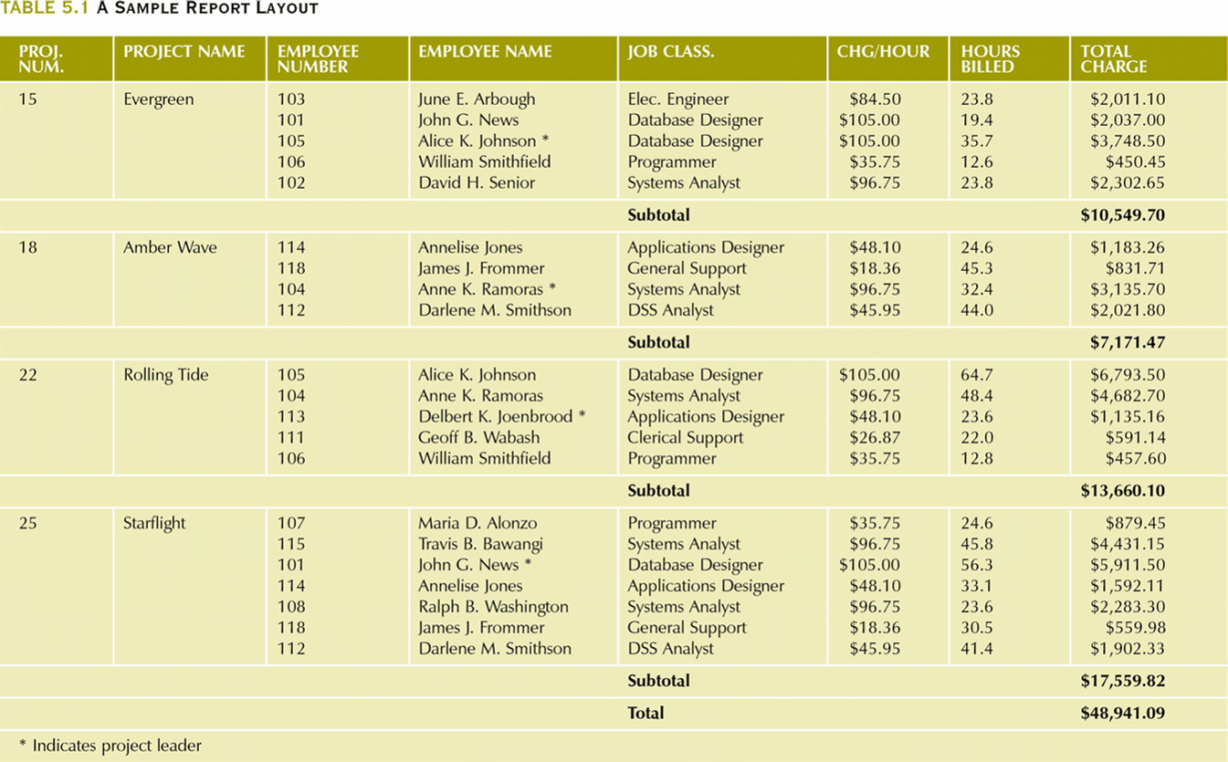
A Sample Report Layout

Slide 6
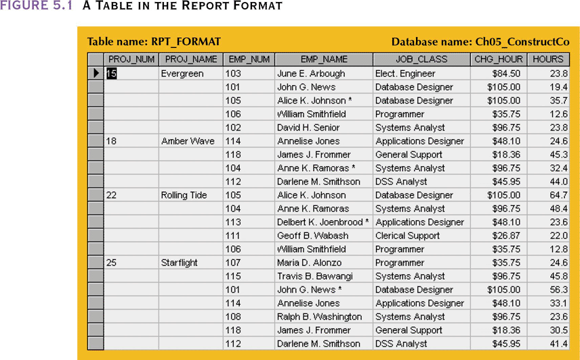
A Table in the Report Format

Slide 7
The Need for Normalization
Structure of data set in Figure 5.1 does not handle data very well
The table structure appears to work; report is generated with ease
Unfortunately, the report may yield different results, depending on what data anomaly has occurred

Slide 8
Conversion to First Normal Form
Repeating group
  Derives its name from the fact that a group of multiple (related) entries can exist for any single key attribute occurrence
Relational table must not contain repeating groups
Normalizing the table structure will reduce these data redundancies
Normalization is three-step procedure

Slide 9
Step 1: Eliminate the Repeating Groups
Present data in a tabular format, where each cell has a single value and there are no repeating groups
Eliminate repeating groups by eliminating nulls, making sure that each repeating group attribute contains an appropriate data value

Slide 10
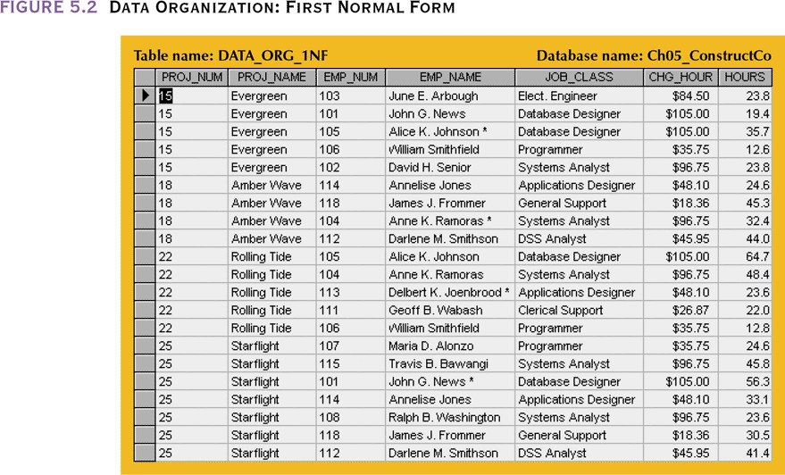
Data Organization: First Normal Form

Slide 11
Step 2: Identify the Primary Key
Primary key must uniquely identify attribute value (PROJ_NUM is not unique)
New key must be composed of PROJ_NUM and EMP_NUM

Slide 12
Step 3: Identify all Dependencies
Dependencies can be depicted with the help of a diagram
Dependency diagram:
  Depicts all dependencies found within a given table structure
  Helpful in getting bird’s-eye view of all relationships among a table’s attributes
  Use makes it much less likely that an important dependency will be overlooked

Slide 13
Step 3: Identify all Dependencies
The arrows above the attributes indicate desirable dependencies i.e., ones that are based on the primary key
  PROJ_NUM+EMP_NUM→PROJ_NAME, EMP_NAME, JOB_CLASS, CHG_HOURS,HOURS
The arrows below the attributes indicate less desirable dependencies
  Partial dependencies – dependent on only part of the PK
    PROJ_NUM→PROJ_NAME
    EMP_NUM→EMP_NAME, JOB_CLASS, CHG_HOUR: only
  Transitive dependencies – a dependency of one nonprime attribute on another nonprime attribute. They still yield data anomalies
    JOB_CLASS→CHG_HOUR

Slide 14
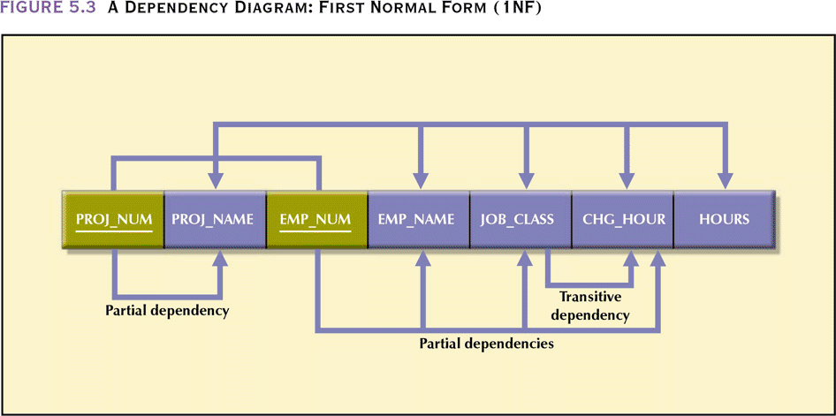
A Dependency Diagram:
First Normal Form (1NF)

Slide 15
First Normal Form
Tabular format in which:
  All key attributes are defined
  There are no repeating groups in the table
  All attributes are dependent on primary key
All relational tables satisfy 1NF requirements
Some tables contain partial dependencies
  Dependencies based on only part of the primary key
  Sometimes used for performance reasons, but should be used with caution
  Still subject to data redundancies

Slide 16
Conversion to Second Normal Form
Relational database design can be improved by converting the database into second normal form (2NF)
Two step process

Slide 17
Step 1: Identify All Key Components
Write each key component on separate line, and then write the original (composite) key on the last line
  PROJ_NUM
  EMP_NUM
  PROJ_NUM EMP_NUM
Each component will become the key in a new table

Slide 18
Step 2: Identify the Dependent Attributes
Using the 1NF dependency diagram, determine which attributes are dependent on which other attributes
  The dependencies are determined by examining the arrows below the diagram
  PROJECT(PROJ_NUM,PROJ_NAME)
  EMPLOYEE(EMP_NUM,EMP_NAME,JOB_CLASS,CHG_HOURS)
  ASSIGN(PROJ_NUM,EMP_NUM,ASSIGN_HOURS)
At this point, most anomalies have been eliminated

Slide 19
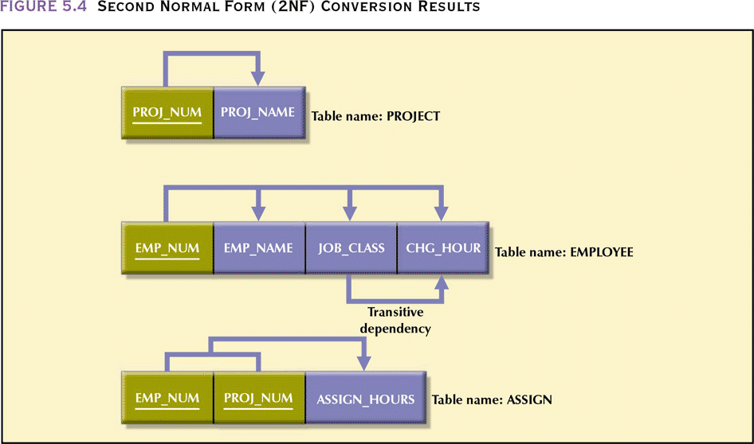
Second Normal Form (2NF)
Conversion Results

Slide 20
Second Normal Form
Table is in second normal form (2NF) if:
  It is in 1NF and
  It includes no partial dependencies:
    No attribute is dependent on only a portion of the primary key

Slide 21
Conversion to Third Normal Form
Data anomalies created are easily eliminated by completing three steps

Slide 22
Step 1: Identify Each New Determinant
For every transitive dependency, write its determinant as a PK for a new table
  Determinant
    Any attribute whose value determines other values within a row

Slide 23
Step 2: Identify the Dependent Attributes
Identify the attributes dependent on each determinant identified in Step 1 and identify the dependency
  JOB_CLASS→CHG_HOUR
Name the table to reflect its contents and function
  JOB

Slide 24
Step 3: Remove the Dependent Attributes from Transitive Dependencies
Eliminate all dependent attributes in transitive relationship(s) from each table that has such a transitive relationship
Draw a new dependency diagram to show all tables defined in Steps 1–3
Check new tables and modified tables from Step 3 to make sure that each has a determinant and does not contain inappropriate dependencies

Slide 25
Step 3: Remove the Dependent Attributes from Transitive Dependencies
  PROJECT(PROJ_NUM,PROJ_NAME)
  EMPLOYEE(EMP_NUM,EMP_NAME,JOB_CLASS,CHG_HOURS)
  ASSIGN(PROJ_NUM,EMP_NUM,ASSIGN_HOURS)
  PROJECT(PROJ_NUM,PROJ_NAME)
  ASSIGN(PROJ_NUM,EMP_NUM,ASSIGN_HOURS)
  EMPLOYEE(EMP_NUM,EMP_NAME,JOB_CLASS)
  JOB(JOB_CLASS,CHG_HOURS)

Slide 26
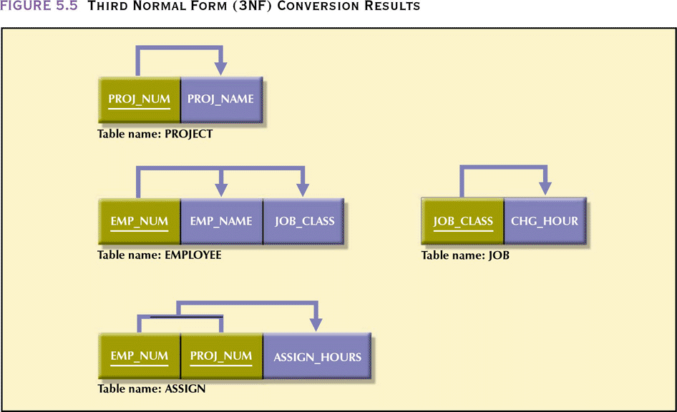
Third Normal Form (3NF)
Conversion Results

Slide 27
Third Normal Form
A table is in third normal form (3NF) if:
  It is in 2NF and
  It contains no transitive dependencies

Slide 28
Improving the Design
Table structures are cleaned up to eliminate the troublesome initial partial and transitive dependencies
Normalization cannot, by itself, be relied on to make good designs
It is valuable because its use helps eliminate data redundancies

Slide 29
Improving the Design
PK assignment
  JOB_CLASS is entered into the EMPLOYEE table for each row. There is still potential for violation of referential integrity if one record has Database Designer and another DB Designer
  Thus, we add a JOB_CODE attribute
    JOB_CODE→JOB_CLASS,CHG_HOUR
    This produces a transitive dependency of JOB_CLASS→CHG_HOUR if you assume that JOB_CODE is a PK
    The benefit of reducing referential integrity errors outweighs the transitive dependency

Slide 30
Improving the Design
Naming conventions
  CHG_HOUR changed to JOB_CHG_HOUR since it is part of the JOB table
  JOB_CLASS is replaced with JOB_DESCRIPTION as it gives a better indication of what the field contains (arguable)
  HOURS changed to ASSIGN_HOURS
Attribute atomicity
  Replace EMP_NAME with fields for first and last name as well as initial

Slide 31
Improving the Design
Adding attributes
  In the real word, the EMPLOYEE table would have many more attributes – YTD gross salary, social security and medicare payments, hire date, etc
Adding relationships
  By using EMP_NUM as a foreign key in PROJECT, we can easily associate all information about a project’s manager with a project
Refining PKs
  It would be better to use a key such as an automaticall generated sequential number called ASSIGN_NUM as a PK rather than EMP_NUM+PROJ_NUM for the ASSIGN table
    If an employee makes two entries in the table for the same project, entity integrity is violated with the composite key
    EMP_NUM and PROJ_NUM would still be used a FKs

Slide 32
Improving the Design
Maintaining historical accuracy
  Writing the job charge per hour into the ASSIGN table, as ASSIGN_CHG_HOUR, is crucial to maintain historical accuracy of the data
    JOB_CHG_HOUR will change over time, we need to know the charge at the time the work was performed
Using derived attributes
    Storing derived attributes makes it easier to write the application software to generate the desired results and save time in generating the report
We now have
  PROJECT(PROJ_NUM,PROJ_NAME,EMP_NUM)
  ASSIGN(ASSIGN_NUM, ASSIGN_DATE, PROJ_NUM, EMP_NUM, ASSIGN_HOURS, ASSIGN_CHG_HOUR, ASSIGN_CHARGE)
  EMPLOYEE(EMP_NUM,EMP_LNAME, EMP_FNAME, EMP_INITIAL, EMP_HIREDATE,JOB_CLASS)
  JOB(JOB_DESCRIPTION,JOB_CHG_HOUR)

Slide 33
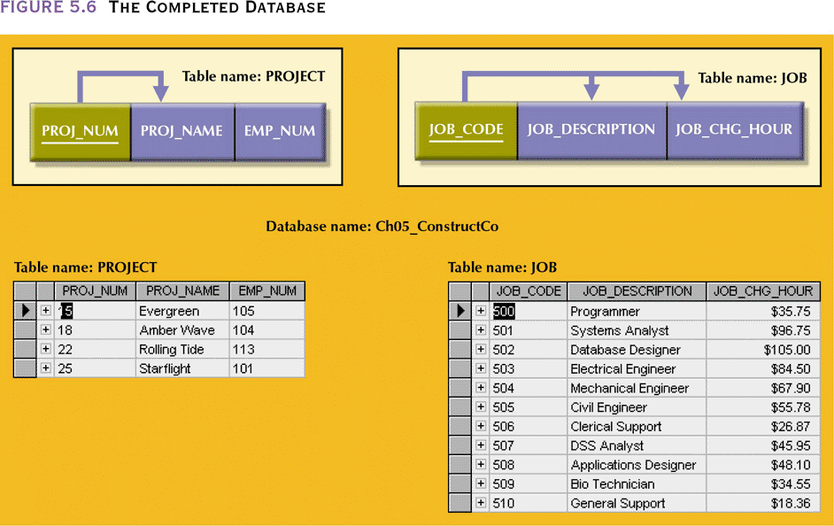
The Completed Database

Slide 34
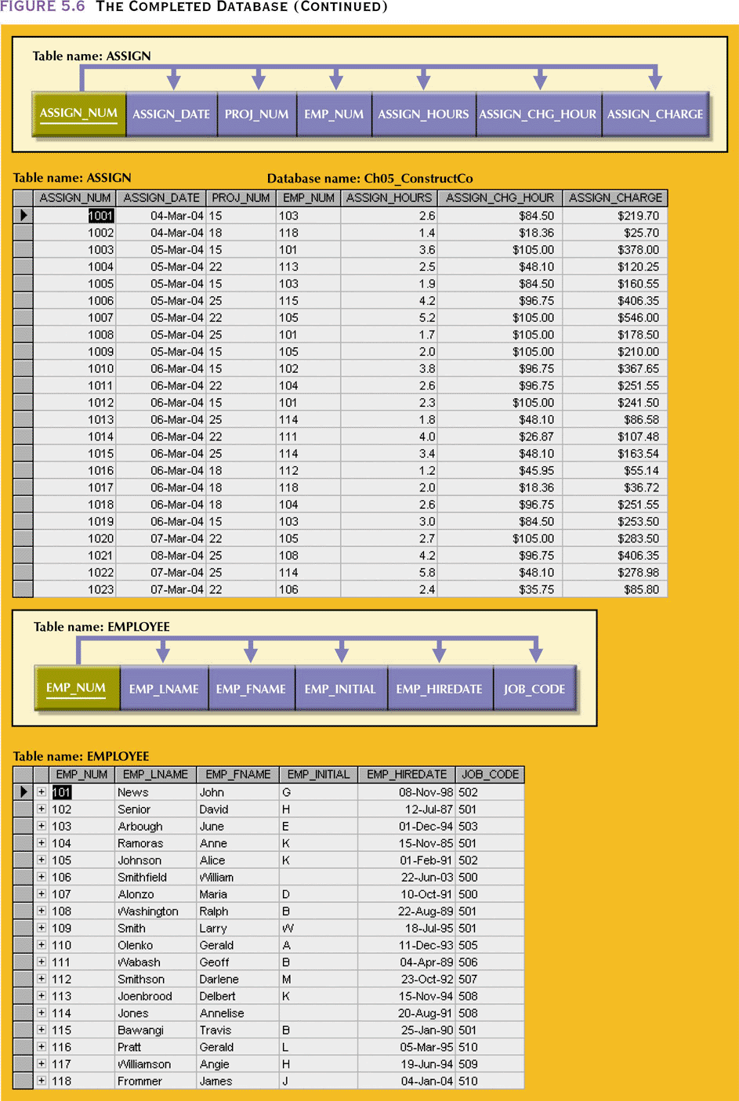
The Completed Database

Slide 35
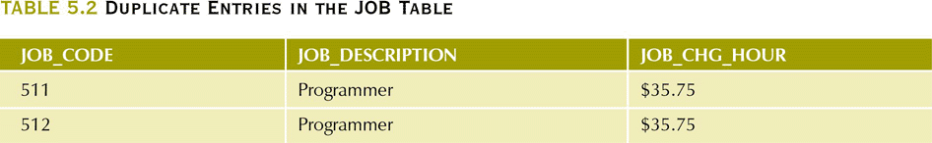
Limitations on System-Assigned Keys
System-assigned primary key may not prevent confusing entries
Data entries in Table 5.2 are inappropriate because they duplicate existing records
  Yet there has been no violation of either entity integrity or referential integrity
  Ensure unique job descriptions by making a unique index on that field
  Trade-off between design integrity and flexibility- manager may want an employee to make multiple entries per day

Slide 36
The Boyce-Codd Normal Form (BCNF)
Every determinant in the table is a candidate key
  Has same characteristics as primary key, but for some reason, not chosen to be primary key
If a table contains only one candidate key, the 3NF and the BCNF are equivalent
BCNF can be violated only if the table contains more than one candidate key

Slide 37
The Boyce-Codd Normal Form
A table is in BCNF if every determinant in the table is a candidate key
  BCNF is violated if a table has more than one candidate key
Most designers consider the Boyce-Codd normal form (BCNF) as a special case of 3NF
  A table is in 3NF if it is in 2NF and there are no transitive dependencies
    A transitive dependency exists when one nonprime attribute is dependent on another nonprime attribute
  A table can be in 3NF and not be in BCNF if a nonkey attribute is the determinant of a key attribute

Slide 38
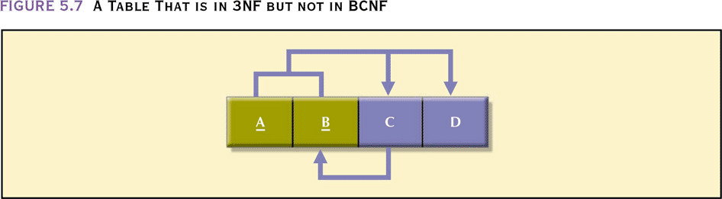
A Table That is in 3NF but not in BCNF
Note these functional dependencies
  A+B→C,D
  C→B (nonkey determines part of the key)
The table has no partial or transitive dependencies so it is in 3NF

Slide 39
Decomposition to BCNF
Change the PK to A+C (since C→B)
  the table is in 1NF since there is a partial dependency C→B
  Decompose table as before

Slide 40
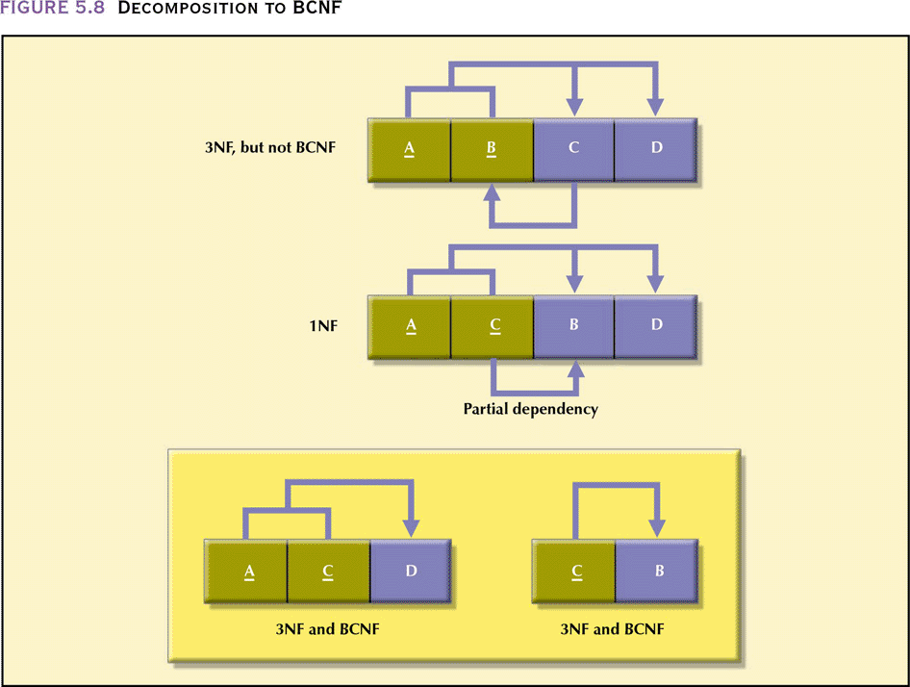
Decomposition to BCNF

Slide 41
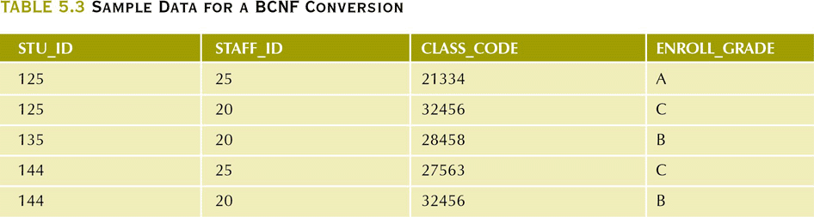
Sample Data for a BCNF Conversion

Slide 42
Sample Data for a BCNF Conversion
CLASS_CODE identifies a class uniquely (might represent course and section)
A student can take many classes
A staff member can teach many classes but each class is taught by only one staff member
In Panel A (next slide) an anomaly can occur when
  The staff member who teacher a course is changed. Each CLASS_CODE has to have the associated STAFF_ID updated
  If a student drops a course, we can lose information about who taught the course

Slide 43
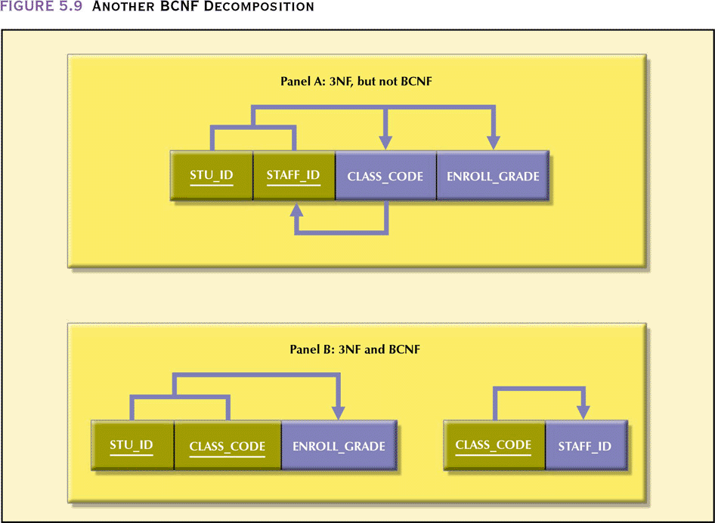
Another BCNF Decomposition

Slide 44
Normalization and Database Design
Normalization should be part of design process
Make sure that proposed entities meet required normal form before table structures are created
Many real-world databases have been improperly designed or burdened with anomalies if improperly modified during course of time
You may be asked to redesign and modify existing databases

Slide 45
Normalization and Database Design
ER diagram
  Provides the big picture, or macro view, of an organization’s data requirements and operations
  Created through an iterative process
    Identifying relevant entities, their attributes and their relationship
    Use results to identify additional entities and attributes

Slide 46
Normalization and Database Design
Normalization procedures
  Focus on the characteristics of specific entities
  A micro view of the entities within the ER diagram
Difficult to separate normalization process from ER modeling process
Two techniques should be used concurrently

Slide 47
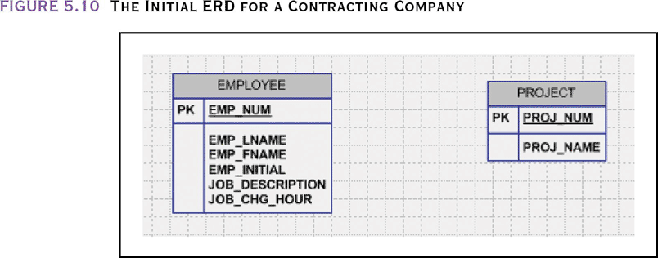
The Initial ERD for a
Contracting Company
Transitive dependency: JOB_DESCRIPTION defines job classifications which in turn determine billing rates (JOB_CHG_HOUR)

Slide 48
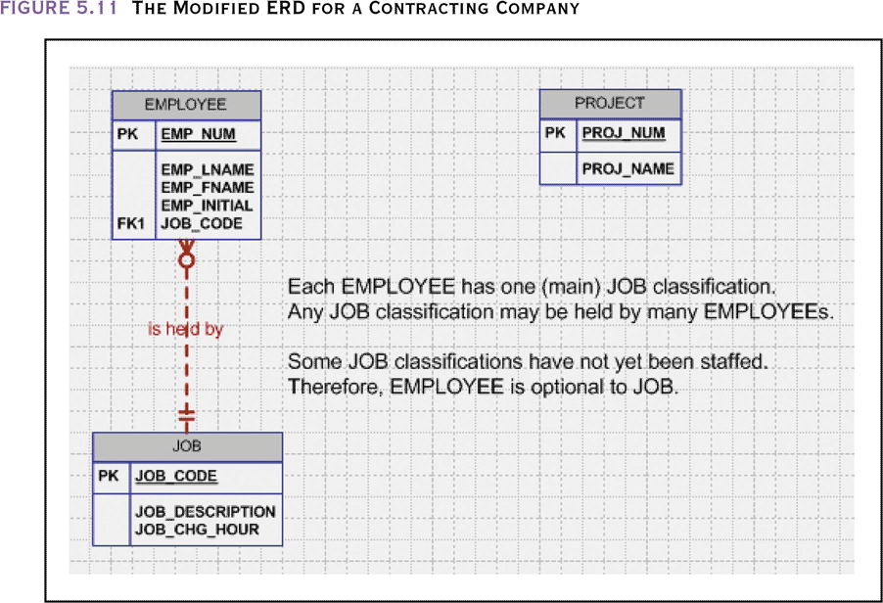
The Modified ERD for a
Contracting Company

Slide 49
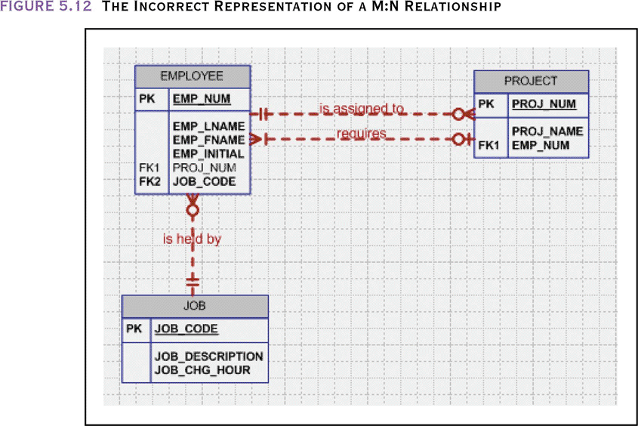
The Incorrect Representation of a M:N Relationship

Slide 50
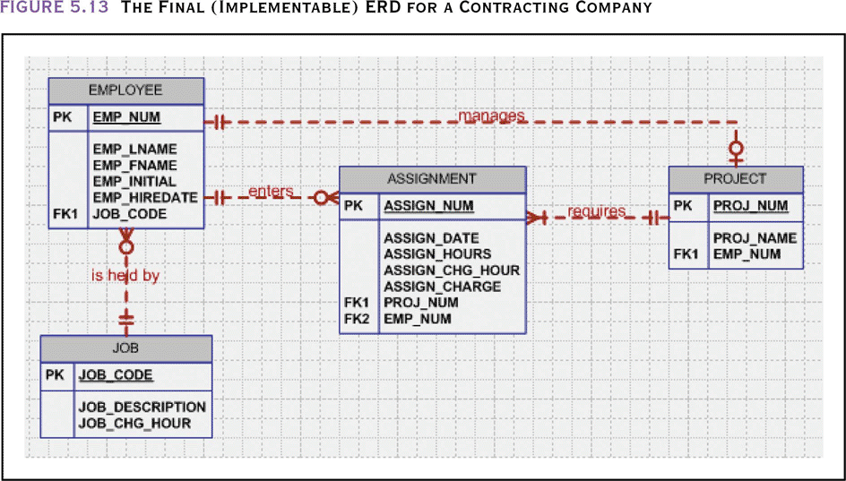
The Final (Implementable) ERD for a Contracting Company

Slide 51
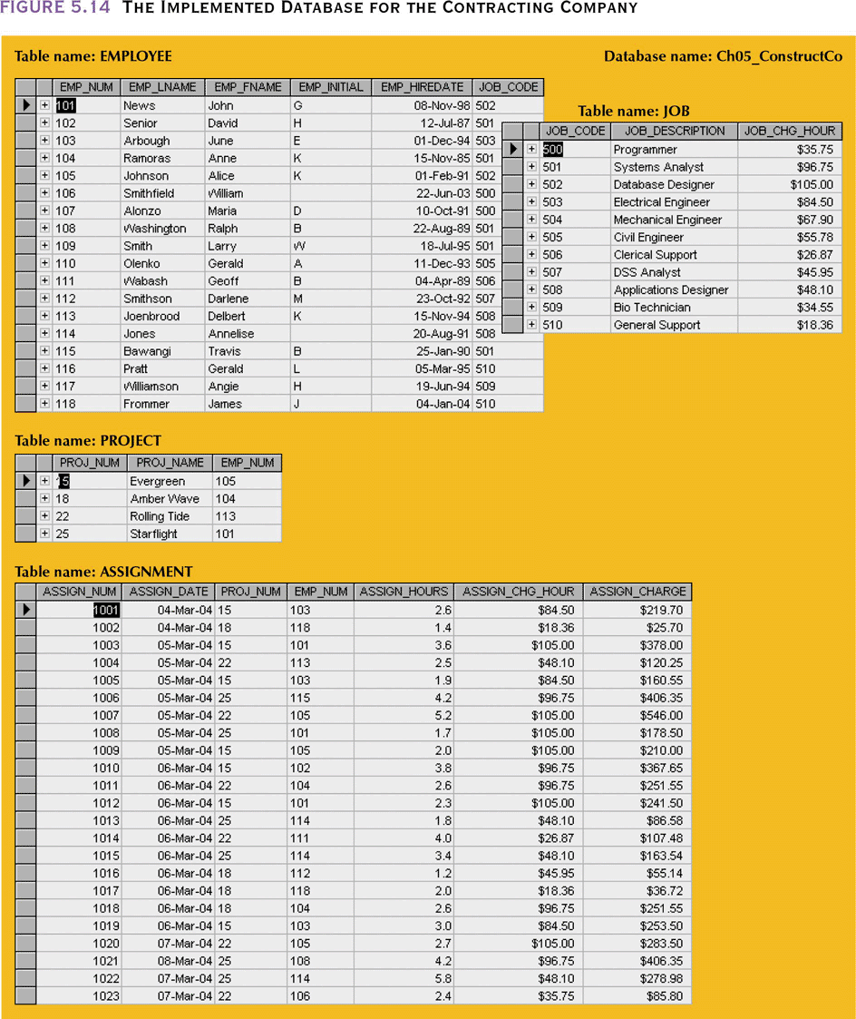
The Implemented Database for the Contracting Company

Slide 52
Higher-Level Normal Forms
In some databases, multiple multivalued attributes exist
  An employee can have multiple assignments and can also be involved in multiple service organizations(Red Cross, United Way)
  Tables on next slide contain two sets of independent multivalued dependencies
    Versions 1 and 2 can have null values so there isn’t a candidate key
    Version 3 is in 3NF but contains redundancies

Slide 53
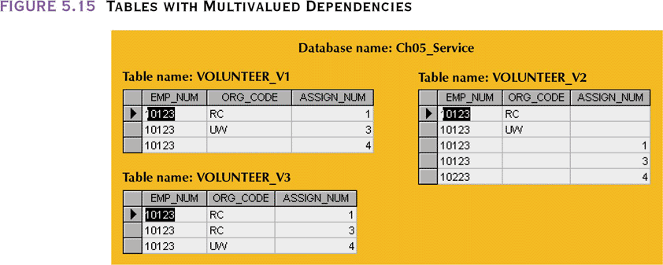
Tables with Multivalued Dependencies

Slide 54
Fourth Normal Form
Table is in fourth normal form (4NF) if
  It is in 3NF
  Has no multiple sets of multivalued dependencies
4NF is largely academic if tables conform to the following two rules:
  All attributes are dependent on primary key but independent of each other
  No row contains two or more multivalued facts about an entity

Slide 55
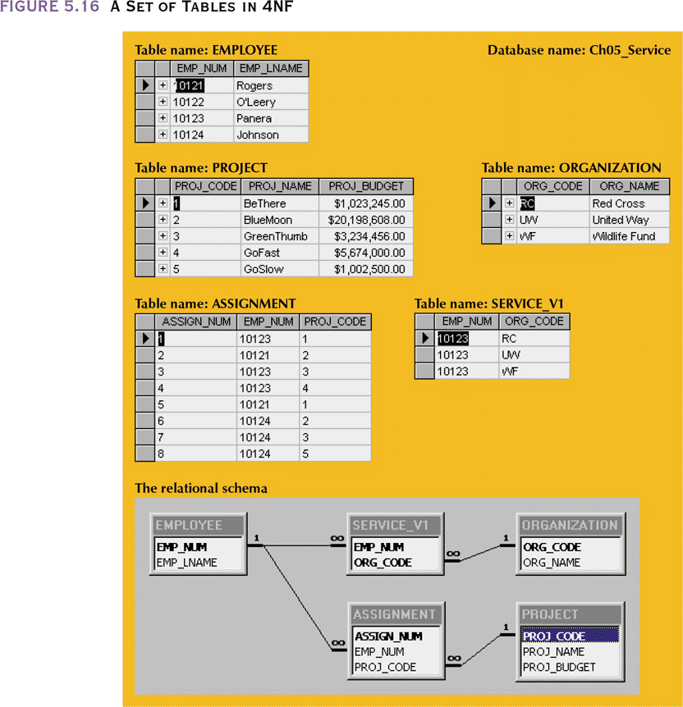
A Set of Tables in 4NF

Slide 56
Denormalization
Creation of normalized relations is important database design goal
Processing requirements should also be a goal
If tables decomposed to conform to normalization requirements,then the number of database tables expands

Slide 57
Denormalization
Joining larger number of tables takes additional disk input/output (I/O) operations and processing logic
  Reduces system speed
Conflicts among design efficiency, information requirements, and processing speed are often resolved through compromises that may include denormalization

Slide 58
Denormalization (continued)
Unnormalized tables in a production database tend to have these defects:
  Data updates are less efficient because programs that read and update tables must deal with larger tables
  Indexing is much more cumbersome
  Unnormalized tables yield no simple strategies for creating virtual tables known as views

Slide 59
Denormalization (continued)
Use denormalization cautiously
Understand why—under some circumstances—unnormalized tables are a better choice

